Slide 1

ECEN 3593-001 Computer Organization
Lecture #29
29 March 2021

Slide 2


Agenda
Class Announcements
Class Project
Finish Chapter 4

Slide 3
Class Announcements
Reading assignment for the week
“Computer Organization and Design, The Hardware / Software Interface, RISC-V edition,” by David Patterson and John Hennessy
ISBN 978-0-12-812275-4
Chapter 5, “Large and Fast: Exploiting Memory Hierarchy”
pages 364-410 (sections 5.1 thru 5.4)
My OH on Zoom today 2:00 to 3:00 https://cuboulder.zoom.us/j/4317981384

Slide 4
Class Announcements
Phases 5 and 6 are in the deduction period – 1%/day
Phase 7 is in the deduction period – 4%/day
Phase 8 is posted
Target Date Sunday, April 4 at 10:00 PM
Bonus 1%/day, deduction 4%/day
Homework #4 is due Thursday, April 1 at 10:00 PM

Slide 5
Homework #4 Typos
Question 3 – Instruction Class C is 40% of the instructions, not 30%
Total must add to 100%
Question 5 – In the third part, the “40% increase” should be 30% to match the previous sentence.

Slide 6
Definitions
Imprecise Interrupt or Imprecise Exception: Interrupts or exceptions in pipelined computers that are not associated with an exact instruction that was the cause of the interrupt or exception
Leaves it up to the operating system to determine which instruction caused the problem
Precise Interrupt or Precise Exception: An interrupt or exception that is always associated with the correct instruction in pipelined computers

Slide 7
Imprecise exceptions
Just stop pipeline and save state
Including exception cause(s)
Let the handler work out
Which instruction(s) had exceptions
Which to complete or flush
May require “manual” completion
Simplifies hardware, but more complex handler software
Not feasible for complex multiple-issue out-of-order pipelines to be decided by software

Slide 8
Precise exceptions
Causing instruction is known
All instructions in front of the exception instruction can be allowed to complete
Any instructions after the exception instruction in an out of order CPU must be voided/flushed
With the advent of out of order instructions to increase performance, precise exception based CPUs are becoming the norm

Slide 9
Instruction Level Parallelism (ILP)
Pipelining: executing multiple instructions in parallel
To increase ILP
Deeper pipeline (more stages)
Less work per stage ⇒ shorter clock cycle
Multiple issue
Replicate pipeline stages ⇒ multiple pipelines
Start multiple instructions per clock cycle
CPI < 1, so sometimes use Instructions Per Cycle (IPC)
E.g., 4GHz 4-way multiple-issue
16 BIPS, peak CPI = 0.25, peak IPC = 4
But dependencies reduce this in practice

Slide 10
Definitions
Instruction-Level Parallelism (ILP): Parallelism among instructions
It can be due to a pipeline where one instruction pipeline stage executes in parallel with another instruction in a different stage
Multiple simultaneous pipelines running together
Multiple Issue: A scheme whereby multiple instructions are launched in one clock cycle
Static Multiple Issue: An approach to implementing a multiple-issue processor where many decisions are made by the compiler before execution
Dynamic Multiple Issue: An approach to implementing a multiple issue processor where many decisions are made during execution by the processor

Slide 11
Definitions
Issue slots: The positions from which the instructions could issue in a given clock cycle
The slots at the beginning of a pipeline
Speculation: An approach whereby the compiler or processor guesses the outcome of an instruction to remove it as a dependence in executing other instructions
Branch prediction is an example of speculation
Issue packet: The set of instructions that issue together in one clock cycle; the packet may be determined statically by the compiler or dynamically by the processor
Very Long Instruction Word (VLIW): A style of instruction set architecture that launches many operations that are defined to be independent in a single wide instruction

Slide 12
Multiple Issue
Static multiple issue
Compiler groups instructions to be issued together
Packages them into “issue slots”
Compiler detects and avoids hazards
Dynamic multiple issue
CPU examines instruction stream and chooses instructions to issue each cycle
Compiler can help by reordering instructions
CPU resolves hazards using advanced techniques at runtime

Slide 13
Static Multiple Issue RISC-V example
In a 2 issue slot static multiple issue processor, the compiler organizes pairs of instructions to be on a 64-bit, 2 word boundaries
The instructions must not be dependent on each other
Reorder instructions to remove or minimize dependencies
If the instructions must be dependent on each other, the later instruction is moved to the next 64-bit boundary an a NOP is inserting in its place
Increase performance at the expense of memory due to the introduction of NOPs

Slide 14
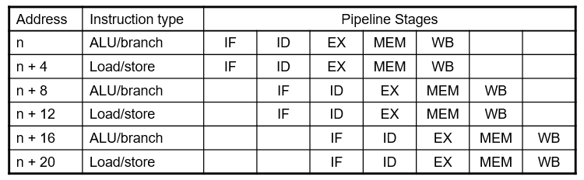
RISC-V with static dual issue
Two-issue packets
One ALU/branch instruction
One load/store instruction
64-bit aligned
ALU/branch, then load/store
Pad an unused instruction with nop

Slide 15
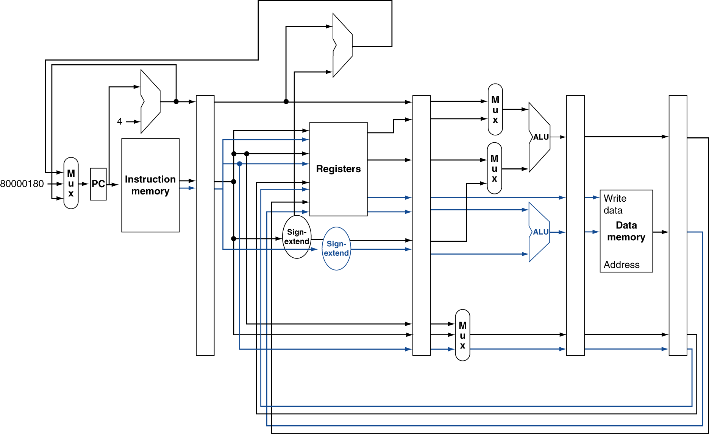
RISC-V with Static dual issue
Fetch 2 instructions
Must add 8
ALU data path
Replicate RF access (R/W)
Load/store data path
8

Slide 16
Hazards in the dual issue RISC-V
Use latency: Number of clock cycles between a load instruction and an instruction that can use the result of the load without stalling the pipeline
More instructions executing in parallel
EX data hazard
Forwarding avoided stalls with single-issue
Now can’t use ALU result in load/store in same packet
add x10, x0, x1 load x2, 0(x10)
Split into two packets, effectively a stall
Load-use hazard
Still one cycle use latency, but now two instructions
More aggressive scheduling (in the Compiler) required
Must schedule no data dependency instruction between the add and load

Slide 17
Chapter 4
You now know how to design a full RISC-V processor !!

Slide 18
Chapter 5
Large and Fast:
Exploiting Memory Hierarchy

Slide 19
Principle of Locality
Programs access a small proportion of their address space at any time
Temporal locality
Items accessed recently are likely to be accessed again soon
e.g., instructions in a loop, loop variables
Spatial locality
Items near those accessed recently are likely to be accessed soon
E.g., sequential instruction access, array data

Slide 20
Taking Advantage of Locality
Memory hierarchy
Store everything on disk
Copy recently accessed (and nearby) items from disk to smaller, faster DRAM memory
Main memory
Copy more recently accessed (and nearby) items from DRAM to smaller, faster SRAM memory
Cache memory attached to CPU
Design Principle – Smaller is Faster

Slide 21
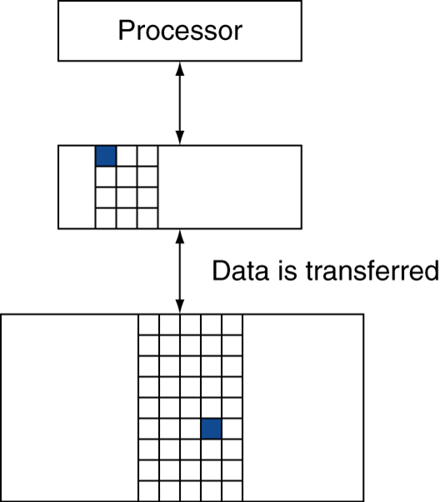
Memory Hierarchy Levels
Block (aka line): unit of copying
May be multiple words
If accessed data is present in upper level
HIT: access satisfied by upper level
Hit ratio: hits/accesses
If accessed data is absent
MISS: block copied from lower level
Time taken: miss penalty
Miss ratio: misses/accesses = 1 – hit ratio
Then accessed data supplied from upper level

Slide 22
Memory Technology
Static RAM (SRAM)
0.5ns – 2.5ns, $2000 – $5000 per GB
Dynamic RAM (DRAM)
50ns – 70ns, $20 – $75 per GB
Magnetic disk
5ms – 20ms, $0.20 – $2 per GB
Ideal memory
Access time of SRAM
Capacity and cost/GB of disk
Cost is inversely proportional to access time. As access time becomes greater, the cost per GB goes down

